Slide 1
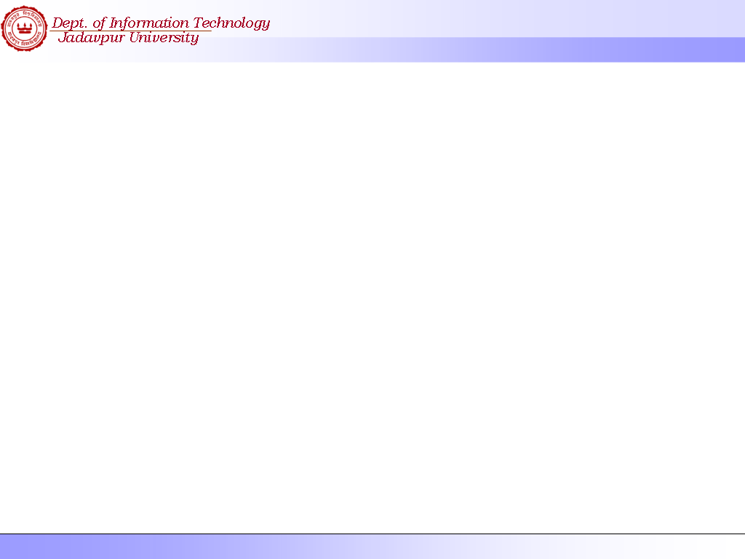
Principles of
Software Engineering
Munmun Das
Dept. of information Technology
Jadavpur University, Salt Lake Campus

Slide 2
Reference :-
1. Fundamental of Software Engineering
by Rajib Mall
2. Software Engineering
A practitioner’s Approach
by R. S. Pressman

Slide 3
Software Engineering Syllabus
Introduction to S/W Engineering.
Software Life Cycle Models
Software Project Management
4. Requirement Engineering
5. Design Concepts
6. Architectural Design
7. Interface Design
8. Software Coding And Testing Technique

Slide 4
What is Software ?
It is NOT just merely a program.
It is the collection of following items:-
- A group of separate programs
- A set of configuration files
- System Documentation
- User Documentation
- A relevant web site to contain all the
latest info about this software.

Slide 5
Software Characteristics
Software is developed or engineered, it is not manufactured in the classical sense.
Software doesn't "wear out.“
Although the industry is moving toward component-based assembly, most software continues to be custom built.

Slide 6
Attributes of A Good Software
Satisfies Functional Requirements
Satisfies Performance Requirements
Should be Maintainable
Should be Dependable
Should be Usable
Should be Portable

Slide 7
What is Software Engineering ?
- Software Engineering is an Engineering discipline which is concerned with all aspects of Software Production.
- It is an Universal Technique for developing large scale system in a cost effective way.

Slide 8
Programming Vs. Software Engg.
Programming
  Individual Writes Complete Program
  One Person, One Computer
  Well-Defined Problem
  Programming-in-the-Small
Software Engineering
  Individuals Write Program Components
  Team Assembles Complete Program
  Programming-in-the-Large

Slide 9
Why Software Engineering?
Program Complexity Transcends Individual or Lone Programmer
Software Engineering Targeted for
  Constructing Large Software Applications
  Defining Problem Clear and Completely
  Tools and Techniques to Support Process
  Team-Oriented Experience
Software Engineering must Evolve to be an Engineering Discipline

Slide 10
Software Engineering - History
“Early Days”
  1950’s Programmers Wrote Programs
  Early 1960’s - Very Large Software Projects Constructed by “Experts”
  Mid-Late 1960’s - Advent of Large Commercial Software Applications
    Large Systems Involved Teams of Individuals
    Coining the Term “Software Engineering”
Towards a Software Engineering Discipline
  Individuals Couldn’t see “Big Picture”
  Increase in Communication Time
  Personnel Changes Impact on Productivity

Slide 11
Software Engineering
Software engineering is:
  An engineering discipline that provides knowledge, tools, and methods for:
    Defining software requirements
    Performing software design
    Software construction
    Software testing
    Software maintenance tasks
    Software project management

Slide 12
Key Challenges facing Software Engg.
Coping with legacy systems
Coping with increasing diversity
Coping with increasing demands for reduced delivery time
Updating software with the latest revision
Curb the ever-increasing cost of producing quality software
Meeting 100% user expectations

Slide 13
Software Development Activities
Software development always includes the following activities (to some extent):
  Requirements analysis
  Design
  Construction
  Testing (sometimes)
These activities do not follow strictly one after another!
  Often overlap and interact
Software Project Management

